Slide 1
EE 295
TechWriting-Engineering Ethics
Oct 1, 2019
Room E 339
Tom Wrappe
EE Lecturer

Slide 2
Agenda
Makeup Class Info
Followup on Midterm Items
Review Topic Submission
Abstract and Outline
Research Deliverable
Draft and Final
Consider Final paper options
Challenger Disaster
Backup Items
IEEE Style Guide
Review
Focus on Citations
Extra Credit Assignment

Slide 3
Makeup Class for Missed Sep 24, 2019 Session
Makeup Class for team (finalized by EE dept):
-6:00 pm Wed, Oct 9 in Room BBC 004 ( Boccardo Business Center).
To be clear, Class will be Tu (Oct 1) and Thu (Oct 3) during week of Sep 30, and,
Tue (Oct 8), Wed (Oct 9) and Thu (Oct 10) during week of Oct 7

Slide 4
Fair Warning
-In Class writing exercise within next two weeks (now down to Oct 1 or 3)
-May be at BEGINNING of class with 30 min allowed INCLUDING Instructions (which begin promptly at 4:30pm or 7:30pm)
-Attend your own section unless granted permission at least 24 hours in advance

Slide 5
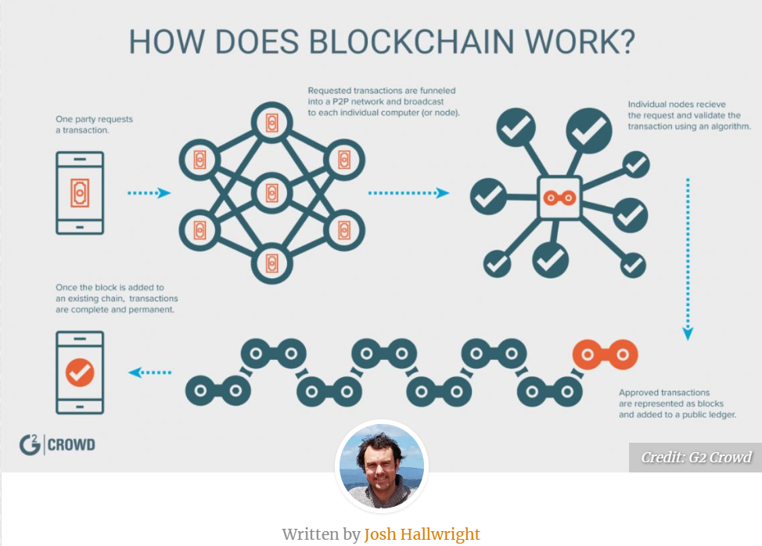
BlockChain “Gadget Descriptions in Grading Process”
To be completed with feedback before Midterm Draft Exercise

Slide 6
Tech Description: Blockchain
General Tech Description Structure | Blockchain Description Flow -Topic sentences (Start of good paragraph)
Intro -Specific object -Quick background -General description of function, cause, effect -Overview of the contents | Blockchain is a secure ledger technology that provides the foundation for multiple advanced services..(Support in remainder of paragraph) Filler: An entire paragraph on the history of Blockchain before a description of what blockchain is
Background | Blockchain was invented in …. and found its first broad application in Bitcoin, the first cryptocurrency.
Discussion of parts/characteristics and highly secure architecture | The architecture of BC provides data records high security based on the embedded hashing codes..(Continue to detail the blocks, the codes and “mining”)
Conclusion | Blockchain is a technology that underlies safe and useful products. In addition to BitCoin, BC enables secure contracts, medical deliveries, etc

Slide 7
Writing Insight for Blockchain: Avoid the Offenders
 | Rank | Issue | Example | Action
1 | 1 | Weak Topic Sentences | BC is gaining popularity in the world. | -Read the topic sentences of your description and see good flow for entire paper.
1 | Filler | Interesting, but distracting narrative beyond the focus of the exercise | -Peripheral Historic facts -Focus on applications when description is the assignment | -Focus on the purpose of the document and limit filler to a transition role either for the beginning or between elements
2 | Passive Voice | -non active statements | -”Blockchain was applied to Bitcoin by Satoshi Nakamoto” | -Review and convert all sentences to active “Satoshi Nakamoto wrote the Bitcoin whitepaper based on Blockchain.”
3 | Pronouns | No “it, I , they” | “Blockchain is a secure ledger technology. It underlies Bitcoin and other valuable services” | “ Blockchain is a secure ledger technology that underlies Bitcoin and other valuable services”
4 | Proper verbs | Choose a time reference and stick to it in all verbs | “Several cryptocurrencies were using Blockchain in 2015” | Reference is real time and is in the past –”used” is past. Go with “Cryptocurrencies used Blockchain..” Also avoid “are using”—”use”

Slide 8
Semester Major Items…..(subject to modification)
 | Mid Term | Resume | Final Paper | Final Presentation (slides )
Topic Paragraph | 9.5.19
Topic Proposed | 9.12.19 |  | 10.3.19
Topic Final | 9.19.19 |  | 10.10.19
Outline/ Abstract | 9.26.19 |  | 10.31.19
Research | 10.1.19 | 10.24.19 (Class) | 10.15.19
Draft Complete | 10.10.19 |  | 11.7.19 | 11.19.19
Final Submit | 10.22.19 | 11.14.19 | 11.26.19 | 12.3.19
Final Presentation | NA | NA | NA | 12.17.19 (Sect 1) 12.12.19 (Sect 2)

Slide 9
A Step Closer to Midterm
Step | Due | Notes
Discuss a topic | 9.5.19 | 1 paragraph on end product (Bring to Class)
Propose a topic/ company | 9.12.19 | 600 words overview of the paper (Turnin)
Abstract/Outline | 9.26.19 | Skeleton of the paper
Research Deliverable | 10.1.19 | Support Element
Draft | 10.10.19 | Complete paper, but needing edit
Final Submission | 10.22.19 | Final product

Slide 10
Midterm-Related Abstract/Expanded Outline
Submit an abstract and a summary outline of the 5-page Midterm Business Proposal
1. Expand on your topic selection
-”Fine tune” your topic
-Create an outline based on the 8 sections of the example (Abstract, Exec Summary, etc....). The Proposed Product is…/The Product is safe and useful because……
2. Prepare one or two full paragraphs (not bullet items, full sentence-based paragraphs) that capture the key elements of each section. UNDERLINE THE TOPIC SENTENCE OF EACH PARAGRAPH.
Begin your market and technology research
-Identify at least 3 market sources for your market research
-Identify at least 2 potential product/technology competitors to your proposed product
3. Provide a “budget” totaling 2800-3000 words –not including the references section--for your “5 Page” Midterm paper (How will you spend your budget on each section of the outline?)
4. Attach Self-Grading Sheet: 1. Grammar checklist
As always, 15% plagiarism or less is required from Turnitin

Slide 11
First 5 page Proposal A Concise version of a Business Plan
Outline | Outline/ Abstract | Draft (5 pages) | Midterm paper (5 pages) | Final Paper ? 15 pages
1. Abstract | Paragraph | ½ page max | ½ page max
2. Executive Summary | paragraph | ½ to 1 page | ½ to 1 page
3. Product Description | 2 paragraphs or so | 1-3 pages
4 Mkt Research and Analysis | 1-2 paragraphs (5 sources min) | 1-3 pages | Depends on sources
5. Finance and Economics | Short paragraph | ½ to 1 page
6. Management Team | Short paragraph | ½ page
7. Risks and Assumptions | Short paragraph | ½ page
8. Conclusions and Recommendations | Short paragraph | ¼ to ½ page
A. Sources | Not Applicable | ½ to 1 page | ½ to 1 page
The outline endures while the content grows

Slide 12
Midterm-Research Assignment For Oct 1:
More sources are better, but perform research on your market and product. Identify each reference source in full IEEE Reference Format followed by a descriptive paragraph :
-Identify at least 3 market sources for your market research and write a paragraph for each source identifying the key information the source provides for the paper.
-Identify at least 2 potential product/technology competitors to your proposed product and contrast them with your product and write a paragraph for each source identifying the key information the source provides for the paper.
Provide a Self Grading Sheet with the following confirmations:
a. Word Count (not applicable, no word limit or minimum, but provide 5 good paragraphs)
b. UNDERLINE THE TOPIC SENTENCE IN EACH PARAGRAPH
c. Grammar checklist: a. No personal pronouns, b. No passive voice, c. no use of "very", d. Complete paragraphs with topic sentence, supporting sentence(s) and conclusion sentence
d. As always, 15% plagiarism or less is required from Turnitin (quote your sources in IEEE format . (See http://sites.ieee.org/pcs/transactions-of-professional-communication/for-prospective-authors/guidelines-to-follow/guidelines-for-preparing-references)

Slide 13
Midterm Research Submission
Descriptive Title with proper Capitalization
Market Sizing Sources
[1] Source 1 in IEEE format
Key research information from Source 1
[2] Source 2 in IEEE format
Key research information from Source 2
[3] Source 3 in IEEE format
Key research information from Soruce 3
Competitive Product Sources
[4] Source 4 in IEEE format
Key research information from Source 4
[5] Source 5 in IEEE format
Key research information from Source 5
Self Grading Sheet
Insert Self Grading Table with confirmation for all rows ensuring that you have verified checklist items

Slide 14
Midterm: First 5 Page Report
The First 5 Page Report will be a Proposal/Business Plan focused on adding a new product to the product line or entering a new area
-Target audience is “your boss” who wants to get the project approved
-Arm her/him with the convincing approach and supporting facts to get the project moving
-Topic areas suggested, but specific paper topic should be put forth by the student
Submit candidate topic writeup (600 words) for approval
Develop interim and final deliverables per Canvas schedule

Slide 15
2nd & 3rd Five Page Reports (Final Paper): Initial Input
The last 10 pages can be a continuation of the Proposal IF you are taking EE297 or EE299. This 15 page Proposal will then be used as a Proposal for your Project.
or
If you are not planning on taking EE297 or EE299 the last 10 pages can be a Research Report for a chosen approved area.
The SPECIFIC Topic should be submitted for approval (selected topics will be presented to the class)

Slide 16
Group Discussions: Finals Group Therapy (Next Class)
Form into groups of no more than 4
Discuss Final Topics ideas within the group and Select a spokesperson for each Discussion topic
Group selects one member to share with the larger group and take questions from the audience
Extend Midterm or Choose a Research Topic
What is the topic? Concise: Either “the proposed product is..” or “the proposed research topic area is”
What is the purpose of the topic? Concise: Either “the proposed product is safe and useful because…” or “ the proposed research area leads to safe and useful products because…”

Slide 17
Challenger Disaster
-Virtue ethics displayed by some involved
-Ignored by others
-Objectivity, Honesty, Caring and Phronesis
Background Facts:
-Launch originally scheduled for Jan 22, 1986, and was delayed 4 times due to multiple issues
-7 crew members all killed in explosion
-Root cause determined to be O-ring failure on the solid rocket booster build by Morton Thiokol
Video Clip

Slide 18
Discussion Items
Key Characters:
Key Decision Points in the Story:
How Virtue Ethics applied at Key Decision Points:

Slide 19
Backup Slides

Slide 20
IEEE Author Center
-IEEE articles and journals have a set process to provide consistency
-http://ieeeauthorcenter.ieee.org/submit-your-article-for-peer-review/the-ieee-article-submission-process/
-Process overview posted on Canvas (Trans_Jour template)
-Provides detail on authoring, peer review, figures, tables for professional journal and symposia submissions

Slide 21
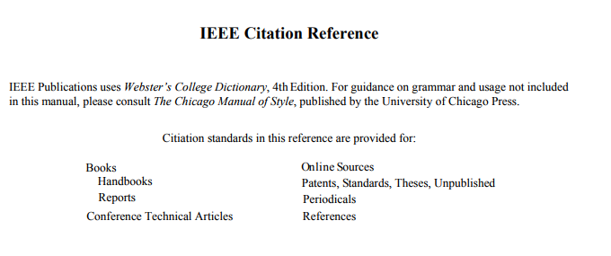
IEEE Citations (For both Midterm and Final) Wikipedia is not an acceptable source above Middle School
http://www.ieee.org/documents/ieeecitationref.pdf

Slide 22
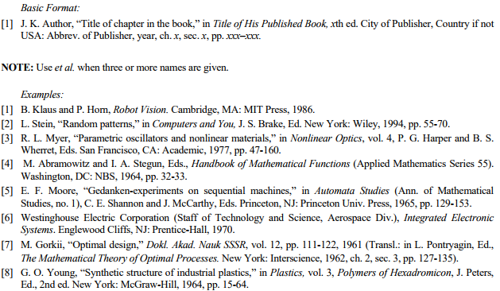
IEEE Citations
Books

Slide 23
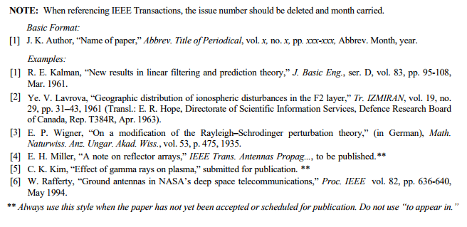
IEEE Citations
Periodicals

Slide 24
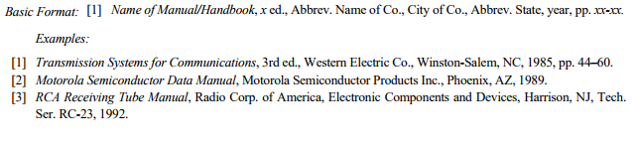
IEEE Citations
Handbooks

Slide 25
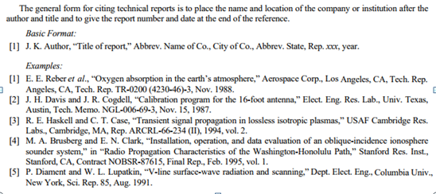
IEEE Citations
Reports

Slide 26
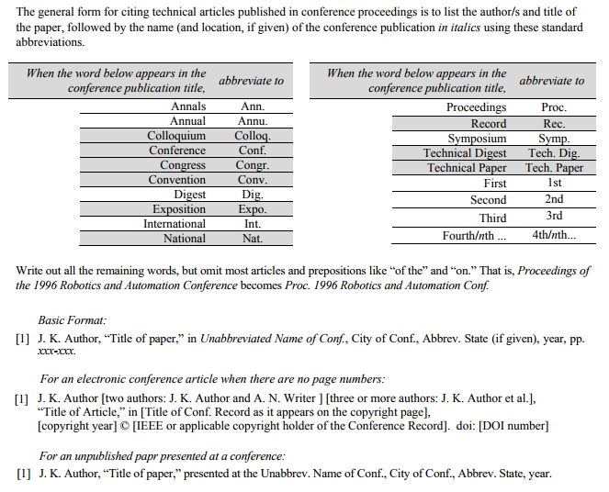
IEEE Citations
Conference Technical Articles

Slide 27
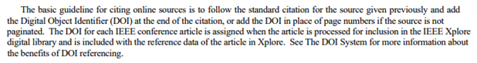
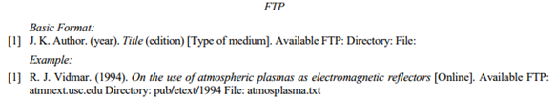
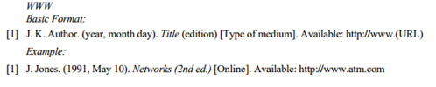
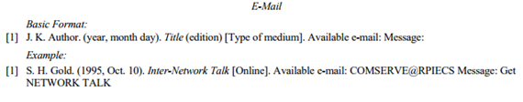
IEEE Citations
Online Sources (CONSIDER ACCESS DATES)

Slide 28
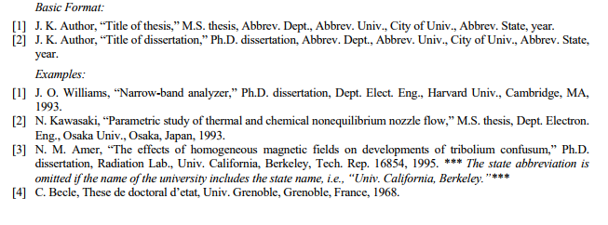
IEEE Citations
Theses and Dissertations

Slide 29
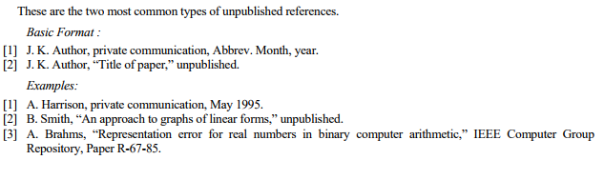
IEEE Citations
Unpublished

Slide 30
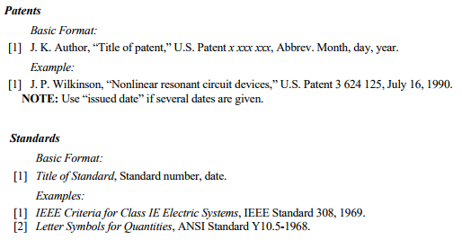
IEEE Citations
Patents and Standards

Slide 31
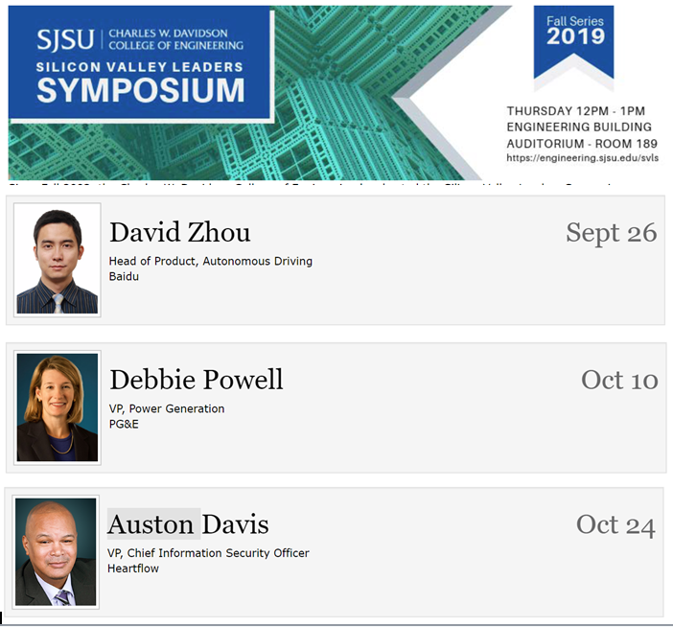
Extra Credit Opportunity: Attend Silicon Valley Leaders Symposium
https://engineering.sjsu.edu/our-college/events/silicon-valley-leaders-symposium

Slide 32
Extra Credit Opportunity
-Up to 10 Total points applied to In-Class Grade
-Attend one of three presentations and provide 300 word writeup (ONLY ONE EXTRA CREDIT; identify in the title of your submission)
-Total points available
-Up to 7 points for informational writeup (from video or in person)
-Total of 10 available for in person attendance (requires submission of code received at the seminar-be there a bit early to avoid being “closed out”)
-Post per instructions on Canvas by assigned due date

